Slide 1
SHOWFER 2.1 UI design v1.5 06/25/2018 © Showfer Media LLC 2018

Slide 2
Different Resolutions
Update
06-25-2018

Slide 3
/* Extra small devices (phones, 600px and down) */
@media only screen and (max-width: 600px) {...}
/* Small devices (portrait tablets and large phones, 600px and up) */
@media only screen and (min-width: 600px) {...}
/* Medium devices (landscape tablets, 768px and up) */
@media only screen and (min-width: 768px) {...}
/* Large devices (laptops/desktops, 992px and up) */
@media only screen and (min-width: 992px) {...}
/* Extra large devices (large laptops and desktops, 1200px and up) */
@media only screen and (min-width: 1200px) {...}
Example from https://www.w3schools.com/css/css_rwd_mediaqueries.asp
SHOWFER GROUPS:
1)Phones Portrait – ALWAYS TRY TO FIT 3 posters in the raw with 3px GAP
2) Phones Landscape - ALWAYS TRY TO FIT 5 posters in the raw with 3px GAP
3) Tablet Portrait – 4 items, left and right margins
4) Tablet Landscape – ALWAYS TRY TO FIT 6 items
5) Desktop ( Landscape) – FIT 3 ROWS, left and right margins

Slide 4













GROUP 1
Phone Portrait
Reference 360x640
SHOWFER
MOVIES
TV
ANIME
COLLECTIONS
My Showfer
The Brava Collection
118 x 177
3
118 x 177
3
118 x 177
12px
12px
12px
6 px
118 x 177
3
118 x 177
3
118 x 177
www.themoviedb.org
www.themoviedb.org
www.themoviedb.org
12px
12px
12px
6 px
+
www.themoviedb.org
www.themoviedb.org
www.themoviedb.org
The Man Cave Collection

Slide 5







Collections PART 2
SHOWFER
The Brava Collection
www.themoviedb.org
www.themoviedb.org
www.themoviedb.org
www.themoviedb.org
www.themoviedb.org
www.themoviedb.org
+
www.themoviedb.org
www.themoviedb.org
www.themoviedb.org

Slide 6
GROUP 2
Phone Landscape
Reference 640 x 360
640x360
SHOWFER
MOVIES
TV
ANIME
COLLECTIONS
My Showfer
The Brava Collection
3
3
3
3
+
12px
12px
12px
12px
12px
6 px
The Man Cave Collection

Slide 7


















GROUP 3
Tablet Portrait
Reference 768 x 1024
MOVIES
TV
ANIME
VIRAL
My Showfer
Action
5%
1.6 % ( of 736_)
5%
0.87
+
Family Friendly

Slide 8




GROUP 4
Tablet Landscape
Reference 1024 x 768
MOVIES
TV
ANIME
VIRAL
My Showfer
Action
1.2 % ( of 1024 )
+
Explicit INDENT

Slide 9


GROUP 4
Tablet Landscape
Reference 1024 x 768
MOVIES
TV
ANIME
VIRAL
My Showfer
Action
+

Slide 10
GROUP 4
Tablet Landscape
Reference 1024 x 768
Action
+
Collapse List

Slide 11
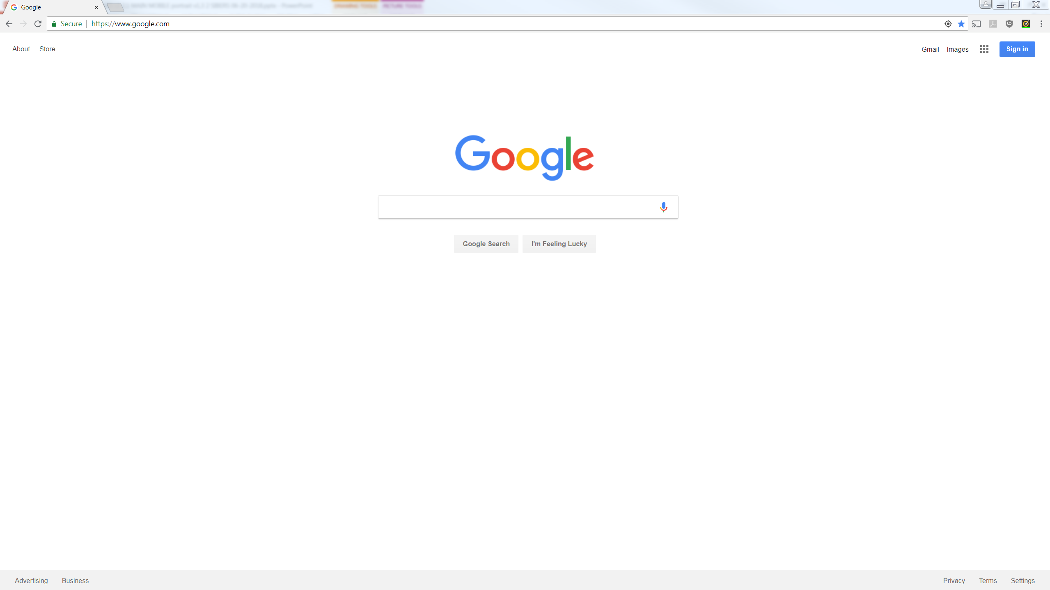
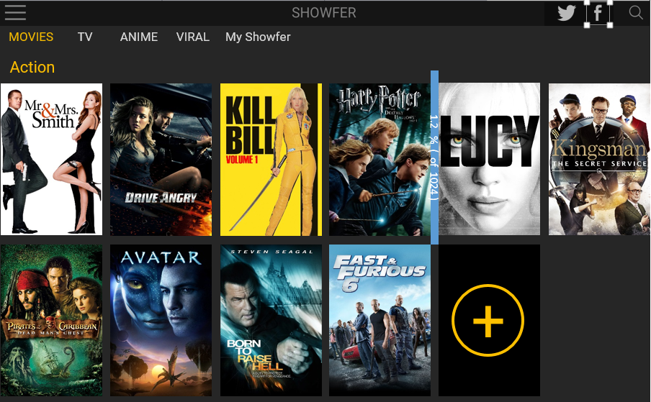
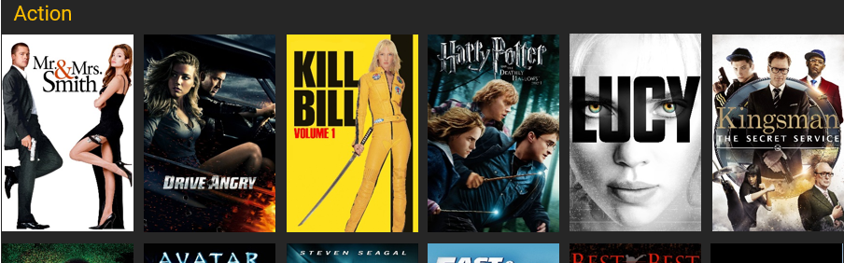
GROUP 5
Desktop Landscape
Reference 1280 x 900
Variable
Approx. 10%
1.8 % ( 1280_)
Variable
Approx. 10%

Slide 12
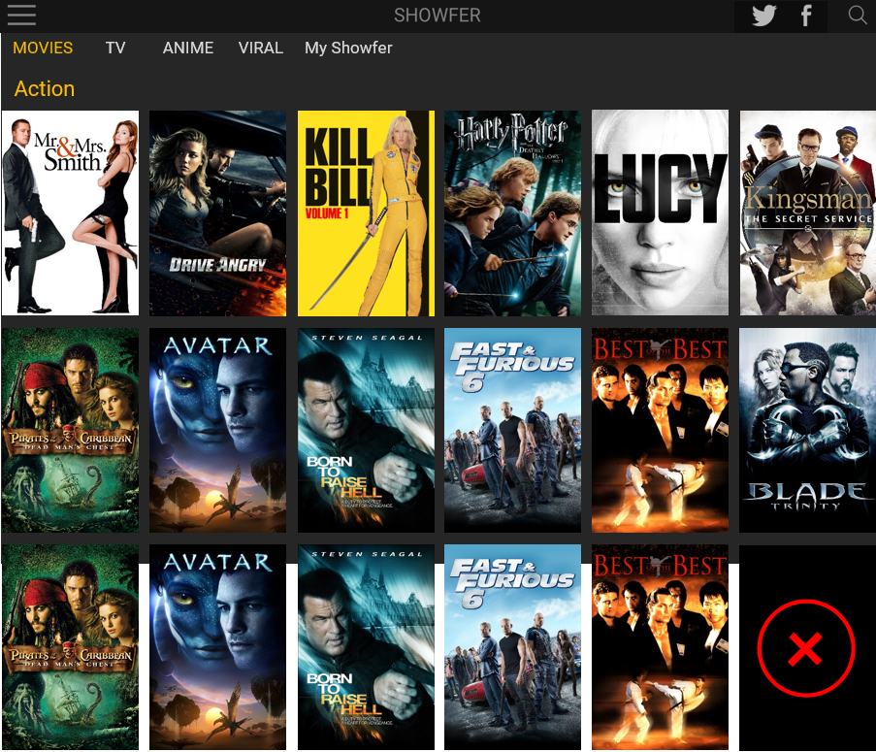
GROUP 5
Desktop Landscape
Reference 1280 x 900
10%
10%
1.8 % ( 1280_)

Slide 13


The Real Housewives of Beverly Hills
Harry Potter and The Deathly Hallows test arrange
Sept 3 1989 by www.rapivideo.com
Sept 3 1989 by www.rapivideo.com
Season 1
Episode 1
Season 1
Episode 1
30
20
Harry Potter and The Deathly Hallows test arrange
20
20
Harry Potter and The Deathly Hallows test arrange
20
25
20
2006 2h 28m Adventure Hction Thriller by www.rapivideo.com arran
2006 2h 28m Adventure Hction Thriller by www.rapivideo.com arran
25
Season 1
Episode 1
Casino Royal ( 4 parts )
30
20
Harry Potter and The Deathly Hallows test arrange
20
20
2006 Adventure Action Thriller by www.rapivideo.com test arrange the
20
25
20
PART 1
2006 2h 28m Adventure Hction Thriller by www.rapivideo.com arran
25
PART 1
Alone in The Wild – Episode 1
30
20
by www.dailymotion.com
Harry Potter and The Deathly Hallows test arrange
20
20
20
25
20
Episode 1
2006 2h 28m Adventure Hction Thriller by www.rapivideo.com arran
25
Episode 1

Slide 14
Harry Potter and The Deathly Hallows test arrange
Part 1 25min
Sept 3 1989 by www.rapivideo.com
Part 2 25min
Season 1
Episode 1
Part 3 25min
Part 3 25min
Harry Potter and The Deathly Hallows test arrange
2006 2h 28m Adventure Hction Thriller by www.rapivideo.com arran
Harry Potter and The Deathly Hallows test arrange
2006 2h 28m Adventure Hction Thriller by www.rapivideo.com arran
Part 1
Episode 1 25min
Season 1 2009 35 Episodes
Harry Potter and The Deathly Hallows test arrange
Episode 2 25min
Season 2 2007 29 Episodes
2006 2h 28m Adventure Hction Thriller by www.rapivideo.com arran
Episode 1
Episode 1 25min
Season 3 2009 35 Episodes
Episode 1 25min
Season 4 2009 35 Episodes

Slide 15





FINAL TV SERIES
SHOWFER
Harry Potter and The Deathly Hallows test arrange
Sept 3 1989 by www.rapivideo.com
Season 1
Episode 1

Slide 16
FINAL MOVIES
SHOWFER
Harry Potter and The Deathly Hallows test arrange
2006 2h 28m Adventure Hction Thriller by www.rapivideo.com arran

Slide 17
FINAL MP MOVIES
SHOWFER
Part 1 25min
Part 2 25min
Part 3 25min
Part 3 25min
Harry Potter and The Deathly Hallows test arrange
2006 2h 28m Adventure Hction Thriller by www.rapivideo.com arran
Part 1

Slide 18
FINAL MP MOVIES
SHOWFER
Part 1 25min
Part 2 25min
Part 3 25min
Casino Royal ( 4 parts )
Part 3 25min
2006 2h 28m Adventure Action Thriller by www.rapivideo.com
PART 1

Slide 19
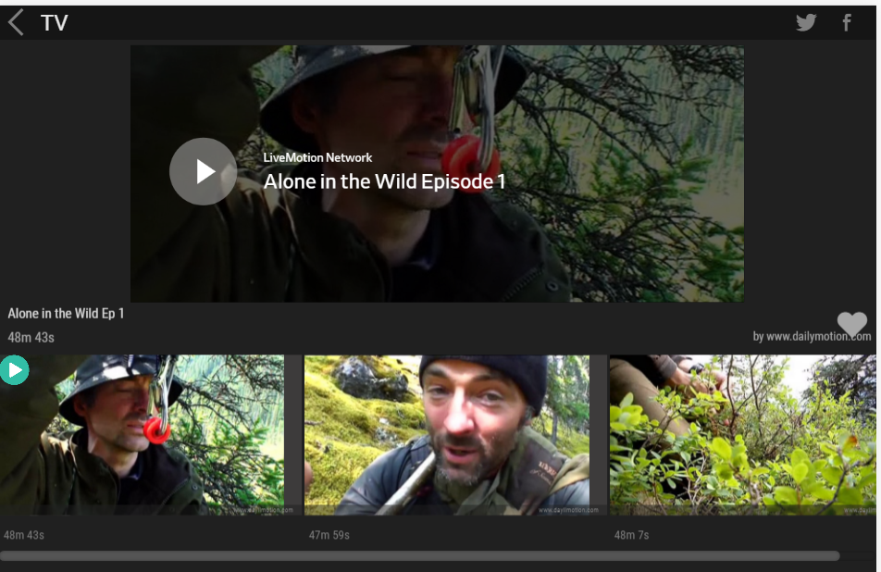
FINAL SHOWFER PLAYLIST
SHOWFER
Episode 1 25min
Episode 2 25min
Episode 3 25min
Episode 4 25min
Harry Potter and The Deathly Hallows test arrange
2006 2h 28m Adventure Hction Thriller by www.rapivideo.com arran
Episode 1

Slide 20
UNIFIED HEADER
FINAL 06-25-2018
Main Menu
SHOWFER
Video Player
SHOWFER

Slide 21
END

